Slide 2
Quality Board Report Q4-FY2019 (July – Sept 2019)

Slide 3
Coronavirus COVID-19 Update

Slide 4
Quality Report Update

Slide 5
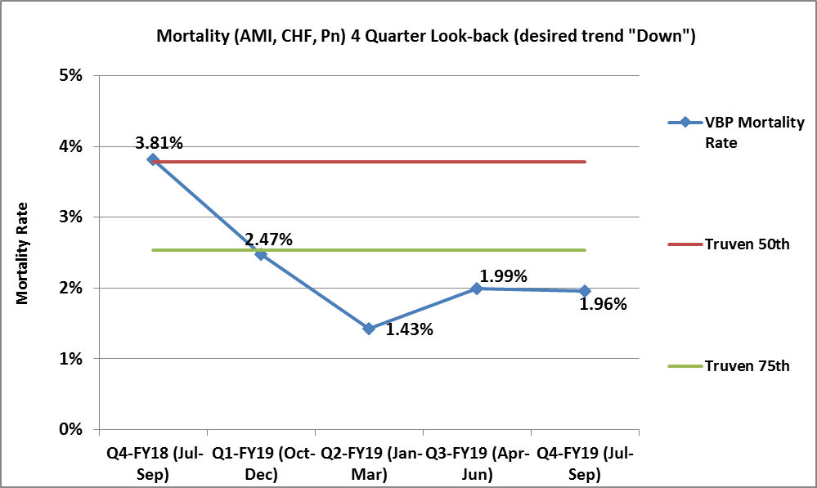
Inpatient Mortality (AMI, CHF, Pn, COPD, CABG)

Slide 6
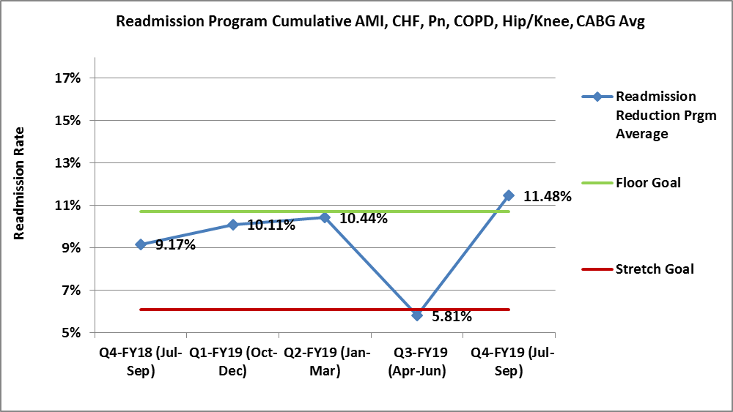
Readmissions (AMI, CHF, Pn, COPD, Hip, Knee, CABG)

Slide 7
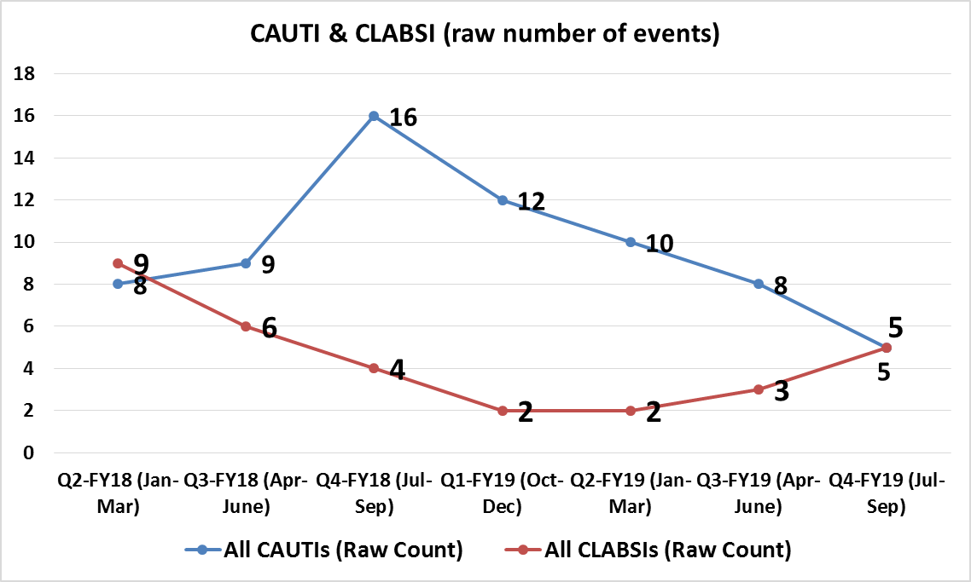

Slide 8
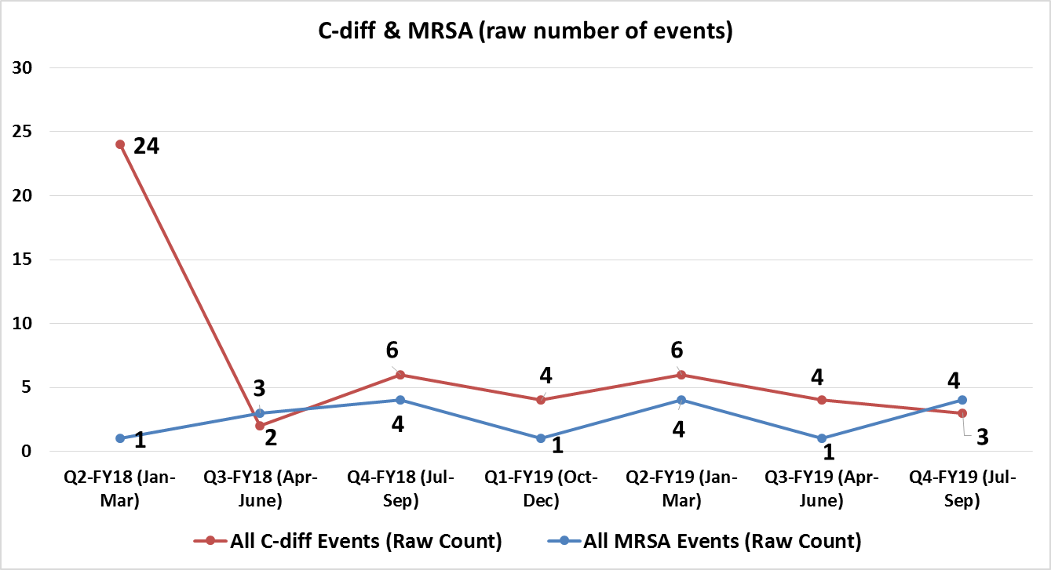

Slide 9
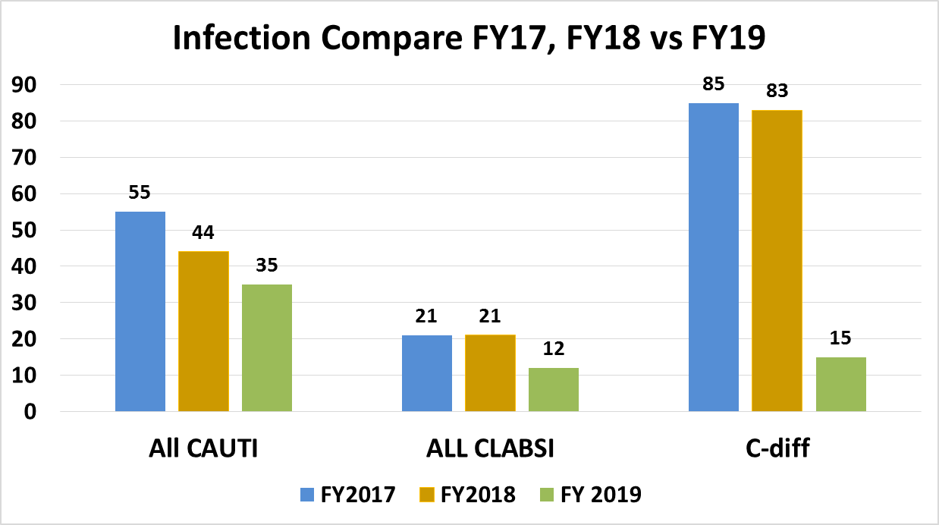
FY17 to FY19
82% Decrease
FY17 to FY19
36% Decrease
FY17 to FY19
42% Decrease

Slide 10
Safety Culture Survey (completed by team members) Update
House Bill 763 (Health Information Transparency) up for vote in the 2020 legislative session
The State to design a patient safety culture survey to be completed annually by hospitals
Measure aspects of:
frequency of adverse events
quality of handoffs and transitions
comfort in reporting a potential problem or errors
level of teamwork within hospital units and the facility as a whole
staff compliance with patient safety regulations and guidelines
staff perception of facility support for patient safety, and staff opinions

Slide 11
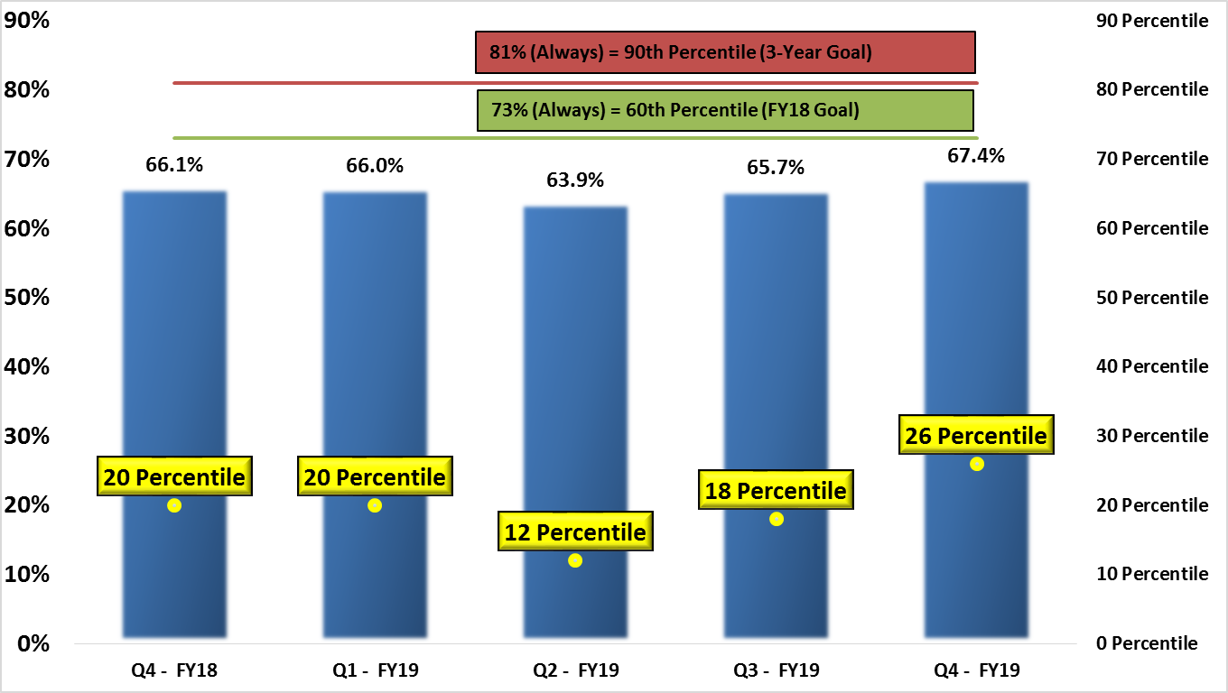
Quality Reports HCAHPS

Slide 12
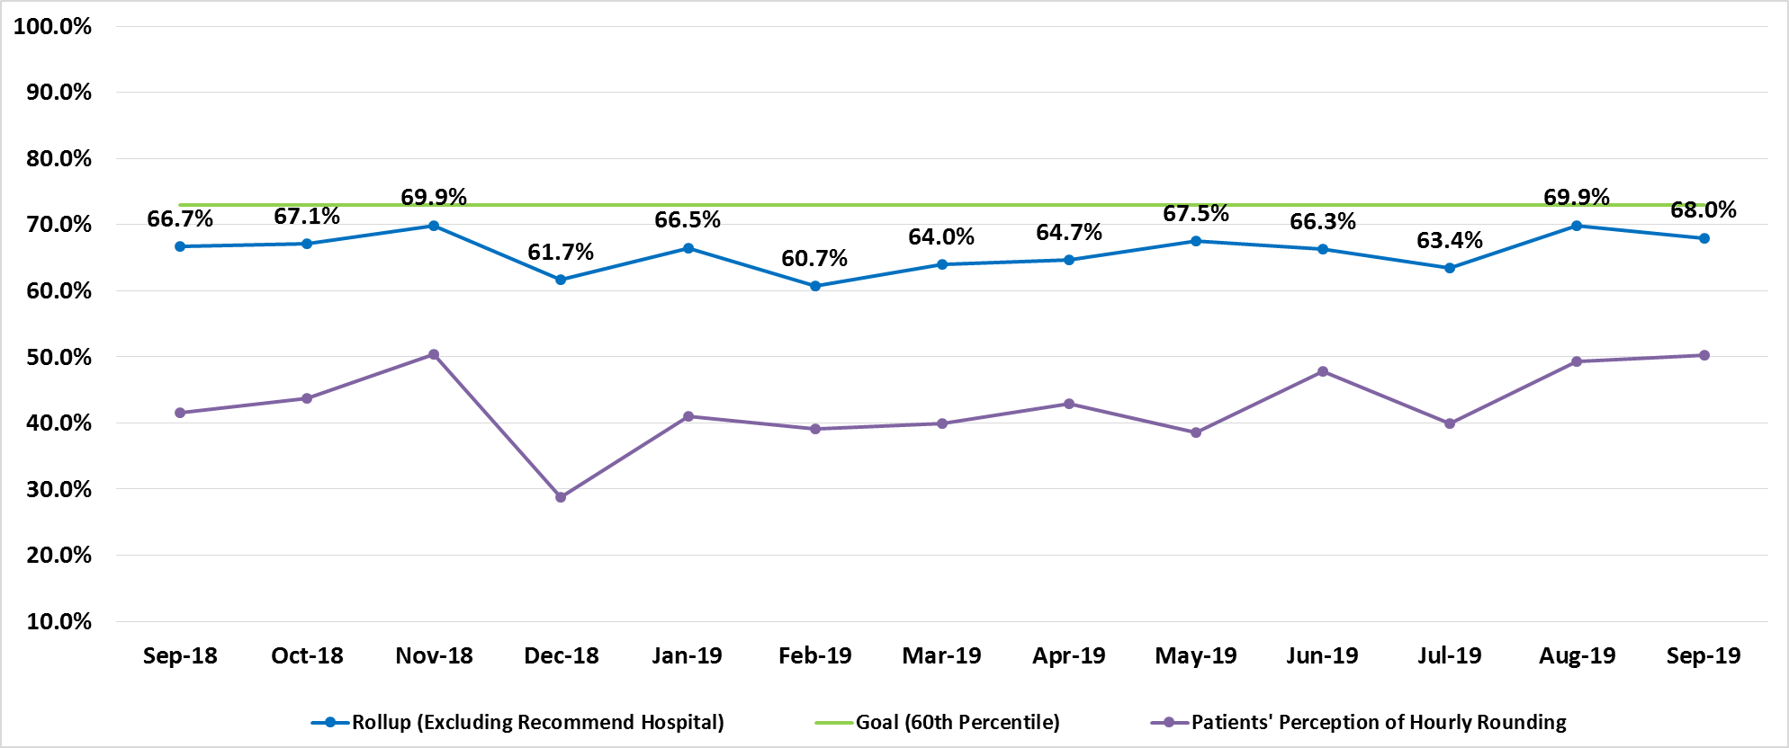
Quality Reports HCAHPS

Slide 13
Patient Ambassador Program

Slide 14
Patient Ambassadors
Program began February 1st, 2020
Role & Responsibilities
Current Staffing: 10 Patient Ambassadors (1st/2nd shift) 4,5,6 & 7N, 7E, CVICU/CIC, HHPO 3rd Floor

Slide 15
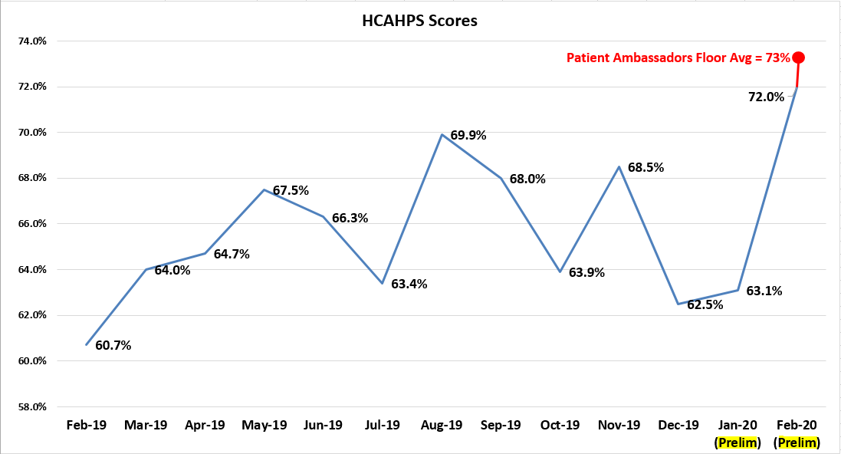
Preliminary February HCAHP Results

Slide 16
This program is new?! It’s like she’s done this work her entire life. Every single moment during my stay, include this moment, has been exceptional!”
“Having a patient ambassador makes everything so lovely. Thank you for everything!”
“This program is wonderful! Jashonti has been amazing during our stay and takes so much off of our nurse’s plate. I’m going to write a review about this!”
“Everything has been consistently improving since the ambassadors stopped in!”
“Before having my Patient Ambassador, everything took awhile to happen. Now, the things I request happen right away!”
“Bryson went above and beyond to make sure I had a hot, fresh meal.”
“Our Patient Ambassador is the best thing that has happened in a long time”!
-Charge Nurse
“Bryson and Brandi saved my life.”
“There has been a significant decrease in call lights and discharge transport times. As a result, we are seeing faster throughput.”
-Nurse Manager
Notes:
Babies and elective plastic surgery – TV story

Slide 17
Questions?

