Slide 2
OPIOID CRISIS: Halifax Health Update
Margaret Crossman MD, FAAFP
Sr VP & CMO - Halifax Health Medical Center
Presented to BOC July 1, 2019

Slide 3
QUESTIONS everyone is asking…
WHERE are we?
HOW did we get here?
And WHERE are we going?

Slide 4
WHERE are we?
The U.S. is using 80% of the world’s prescription opioids
30% of chronic pain patients misuse/abuse prescription opioids
50% of heroin addicts started with prescription opioids
> 100 U.S. deaths per day from opioid overdose
> 45,000 deaths per year

Slide 5
AMPS at Halifax Health Assessing and Managing Pain Safely
MISSION
Provide strategic guidance to improve Assessment and Management of Pain, enhance the Safety of opioid therapy when required, and positively impact our community
VISION
Establish best practices and hardwire cultural change through standardized tools and resources, and expanded use of alternative pain management options, and safer use of opioids when indicated

Slide 6
Operationalizing: a New Day in Pain Management
Educate and expand available resources
Use best evidence, consensus guidelines
Electronic-prescribing (E-prescribing) of controlled substances
Expanded Prescription Drug Monitoring Program (PDMP) accessibility
Incorporation of clinical decision support tools in EMR
Acute pain – limit to 3 day supply (7 day exception)
Monitor and provide feedback to prescribers
Medication Assisted Treatment (MAT) for Substance Use Disorder (SUD)

Slide 7
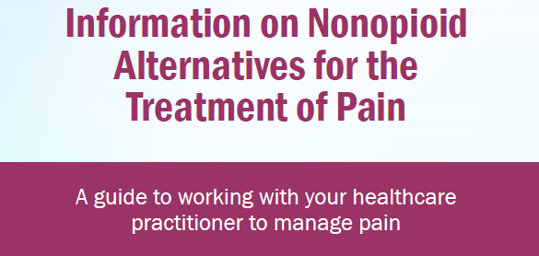

Slide 8
Pharmacy: Opioid Purchases 2017 versus 2018
Down 30%

Slide 9
#Opioid tablets prescribed at discharge from Inpatient Units
Fentanyl prescriptions fell from 26 to 2
12.5%
28.5%

Slide 10
Reduction in ED Dilaudid use Jan-May 2017 versus 2018

Slide 11
ED total opioid prescriptions and # tablets Jan-May 2017 versus 2018

Slide 12
3 Year Snapshot:
498 Opioid Overdoses
352% increase 2016-2018

Slide 13
HOW did we get here?
INCREASED societal expectation, life expectancy, obesity, survivorship, frequency and complexity of surgery
Introduction of pain scales ~1980
5th vital sign JAHCO ~2000
Sensitized (easily exploited) prescribers
Path of least resistance
What’s reimbursed
Satisfaction scores

Slide 14
Reward Circuit designed to sustain life and build community
REWARD CENTER
Pleasure/ relief, driven by instinctual needs
REGULATES REACTIONS
Moods, stress, anxiety, irritability, discomfort
Early EXECUTIVE FUNCTION
Think, plan, problem solve, impulse control
Adapted from https://www.drugabuse.gov/publications/drugs-brains-behavior-science-addiction/drugs-brain

Slide 15
Hi-jacked!
Exposure to addictive drug or unnatural activity, produces excessive pleasure
Self control over-ruled by craving, leads to substance seeking and preoccupation with use
Absence leads to negative emotions and physical symptoms (pain, etc.)
Adapted from https://www.addiction.surgeongeneral.gov/sites/default/files/chapter-2-neurobiology.pdf

Slide 16
NATURE
NURTURE
Exposure to drug or activity

Slide 17
Morphine, heroine, etc..)
Pain relief, euphoria, drowsy, respiratory depression
Blunts effects
Blocks effects
Adapted from https://www.livengrin.org/stop-alcohol-cravings/drugs-to-stop-drinking/

Slide 18
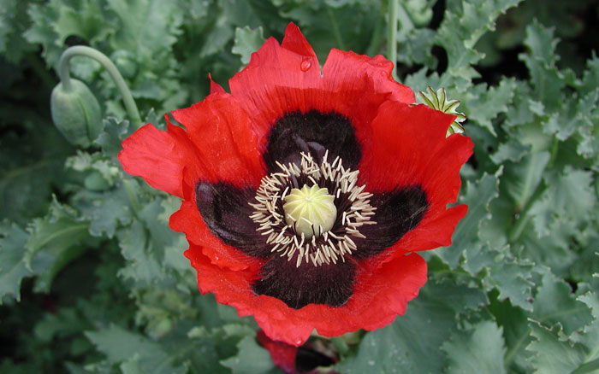
Opioid History: ancient to modern day
3400 BC Opium Poppy growth and cultivation in SW Asia “Joy plant”
2ndc Greek cultivation of poppy plant
7thc China medicinal use
17thc Laudanum
18thc Opium Wars
19thc Morphine extracted from poppy, synthesized codeine, then heroine, thought to be less addictive than morphine
20thc Synthesized oxycodone, methadone 1939, buprenorphine 1966
21stc Naloxone added to increase safety

Slide 19
Opioid Addiction IS…
Better to prevent
Treatable, but complex
Survivable
Worth the time and effort
A critical life threatening disease, with far reaching consequences

Slide 20
DEVELOPING BEST PRACTICES for SUD
MAT recognized by SAMHSA as a best practice for reducing illicit opioid use, overdoses, and mortality
ED Initiated MAT:
significantly increased likelihood of pt getting formal addiction Rx, reduced self-reported illicit opioid use
Warm Hand-Offs
Personalized care transition from acute care to definitive addiction treatment
Further increased capture and retention rates in treatment programs
Journal of Med Toxicology 2018;14:306 SAMHSA Substance Abuse and Mental Health Services Administration

Slide 21
Refining the OPIOID CRISIS Response
Shut down the Network/Grid
Federal and state regulations to educate and change practice
Shut down “pill mills”
Save lives at first responder and ED level
Increase Naloxone availability
Warm hand-offs to Medication-Assisted Treatment (MAT)
Expand Capacity for Opioid Addiction Treatment
Limited resources
Must justify requests for allocation of additional $$

Slide 22
Halifax Health All In for Florida
The Emergency Room Intervention Project

Slide 23
ED Intervention Project – All In for Florida
Spearheaded by Florida Alcohol and Drug Abuse Association (FADAA) & Florida Hospital Association (FHA)
Grant from Aetna, endorsed by Florida College of Emergency Physicians (FCEP)
Statewide Pilot Initiative to insert Certified Peer Specialists (CPS) in Regional Healthcare system EDs to facilitate warm hand-offs into addiction treatment
Treatment-ready individuals are given initial MAT dose in ED
Requires partnership with hospital and regional MAT providers
Halifax Health is one of 6 hospitals participating in the state

Slide 24
Project Status – Halifax Health
Partnership between Halifax Health and Stewart Marchman Rehab and Addiction Treatment Center (SMA)
SMA funding ED based Peer Counselor position (1 FTE)
Qualifications identified
MOU (Memorandum of Understanding) in process
Baseline hospital data collected
Collaboration includes Volusia County EMS, will contribute data

Slide 25
Halifax Health Pilot Go Live August 1, 2019
Limited population: Near fatal overdoses
Estimate will enroll 1 patient per wk, 30 total patients for pilot
Anticipate 1 year data collection and analysis
Help develop broader guidelines and recommendations
Justify funding needs

Slide 26
Overview
MD obtains consent if patient agrees to treatment
Bedside Peer Counselor assists with transition to outpatient MAT
If Peer Specialist unavailable, video technology provides 24/7 SMA staff to engage patient and facilitate transition for outpatient MAT
Goal: Patient in addiction treatment clinic <3days after ED visit
Follow metrics, adjust to optimize, report data centrally

Slide 28
WHERE are we going?
Research and develop evidence-based guidelines
Increase focus on prevention programs
Enhance coverage for non-pharmacologic and non-opioid treatment options
Develop greater and more informed workforce to address SUD

Slide 29
“Dwelling on the past robs the present, ignoring the past robs the future.”
Quote from Zweiback, A.M, & Doniger, W. (February 1, 1973). Kung Fu, Episode 7, The Tide. In Warner Bros. Hollywood, CA: WB Entertainment Inc.

